Slide 1
Family Photo's

Slide 2
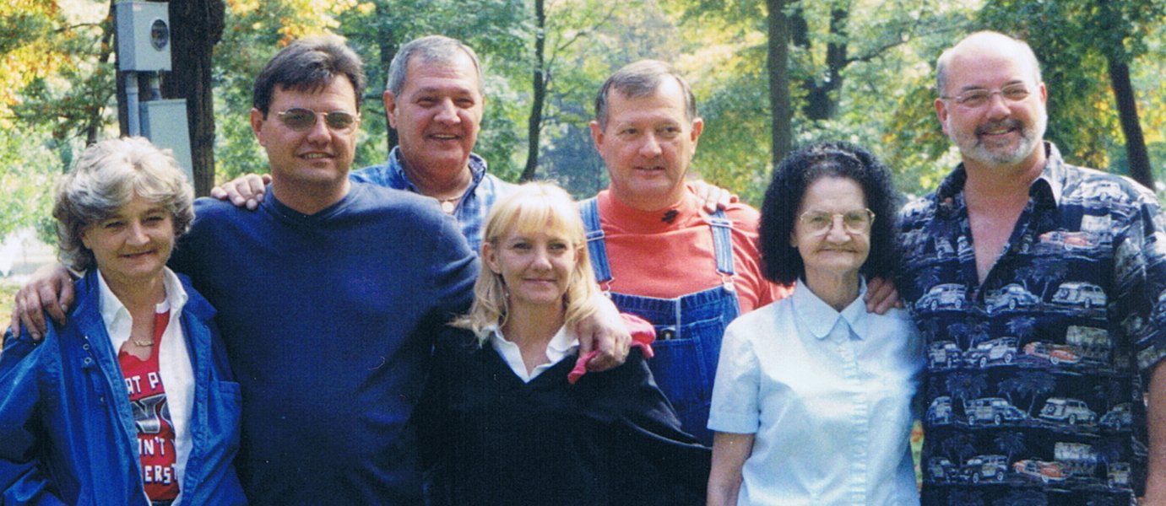
Barbara, Mark, John, Libby, Arnold, Elizabeth, & Jerry

Slide 3
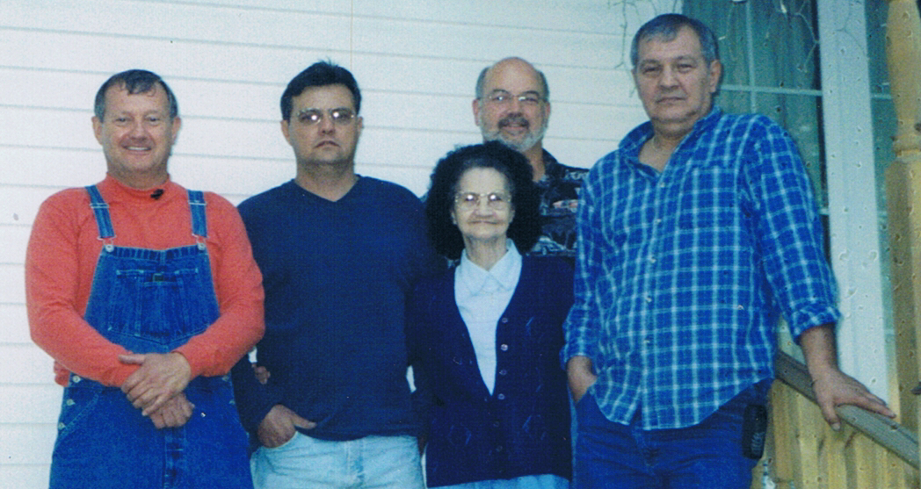
Arnold, Mark, Mom, Jerry & John

Slide 4
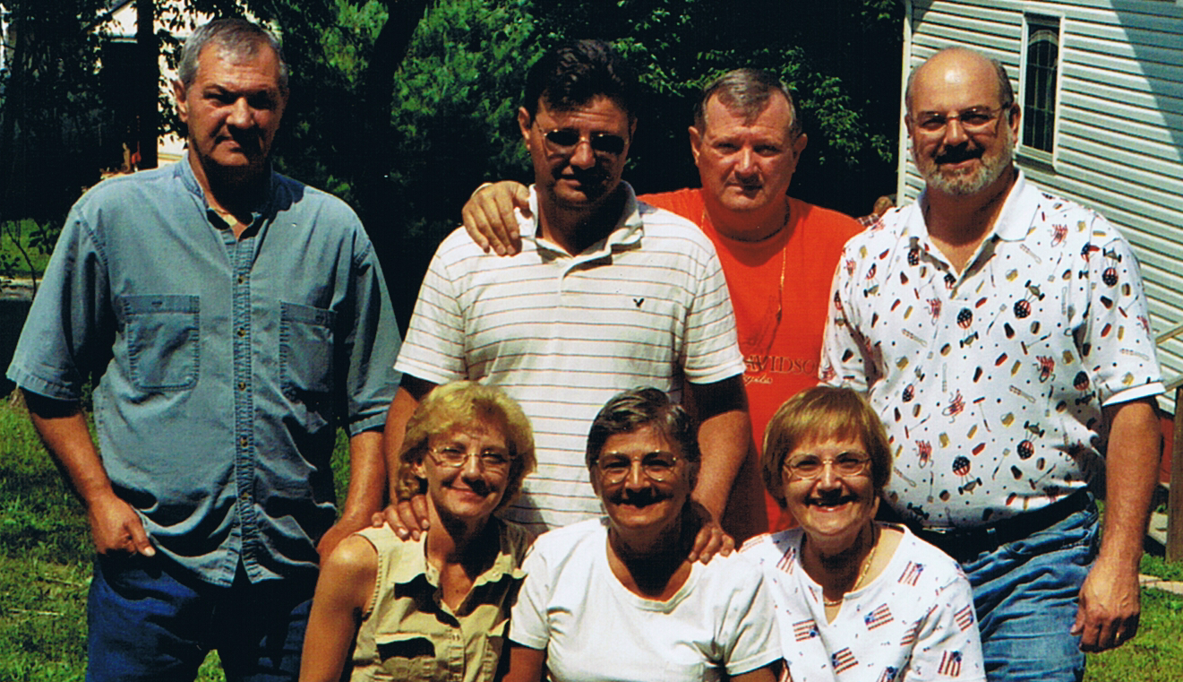
John, Mark, Arnold, Jerry, Libby, Barbara & Frankie

Slide 5
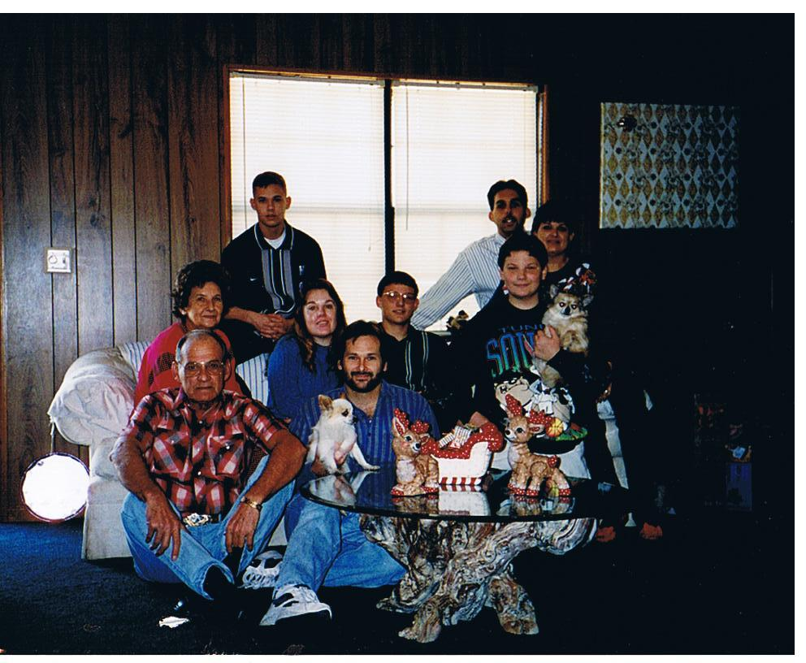
David Lee & Family

Slide 6
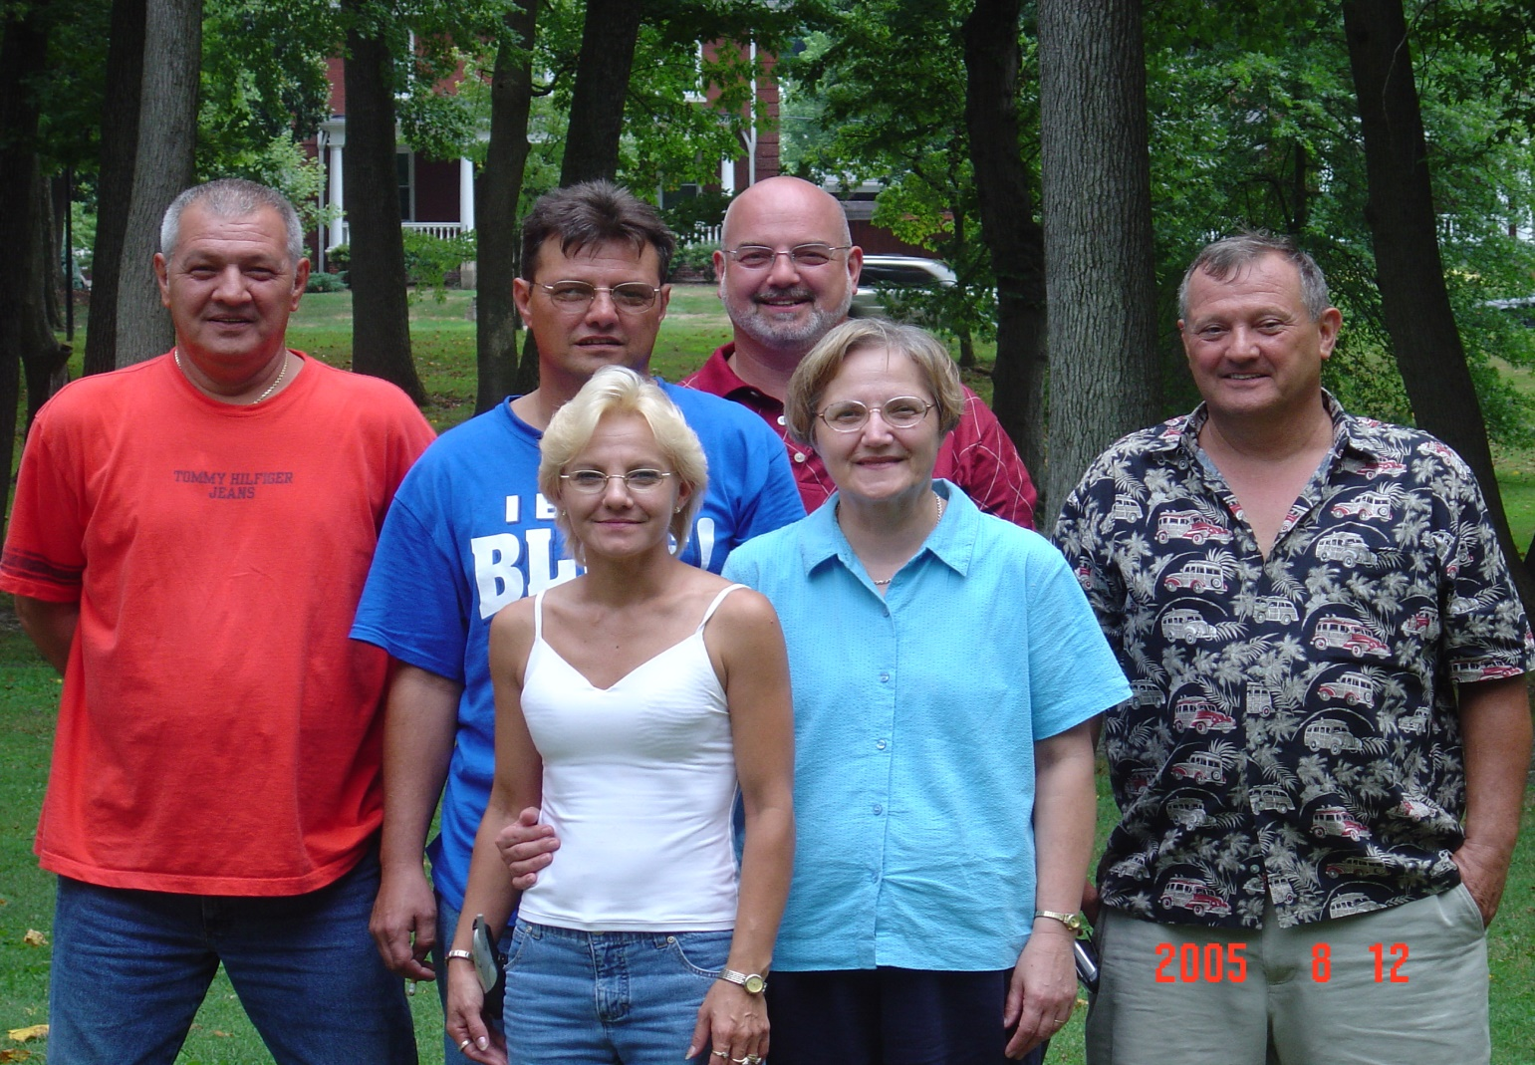
John, Mark, Jerry, Arnold, Libby & Frankie

Slide 7
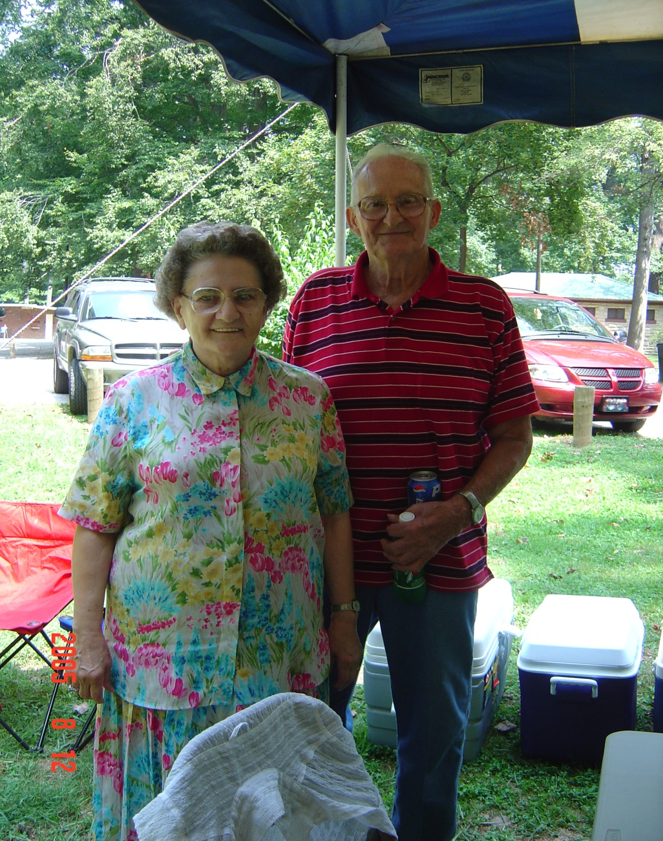
Bill & Harriet Sarvin

Slide 8
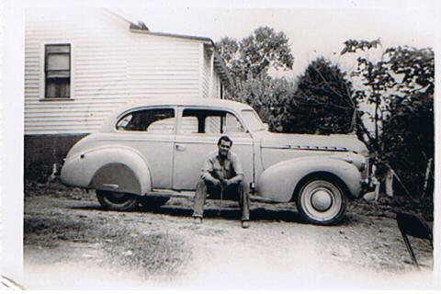
Arnold Maynard Sr.

Slide 9
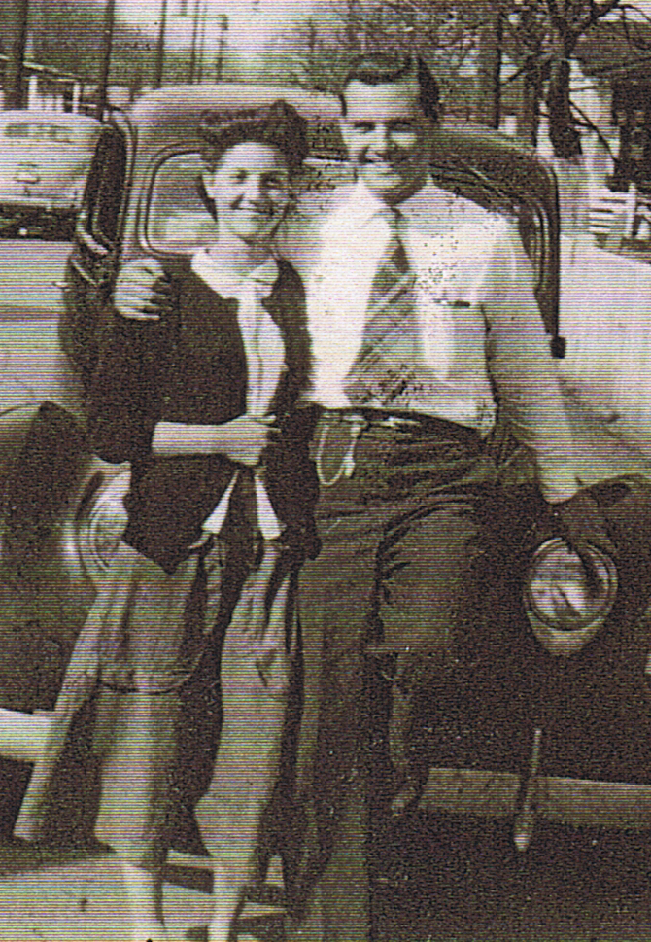
Arnold & Elizabeth Maynard

Slide 10
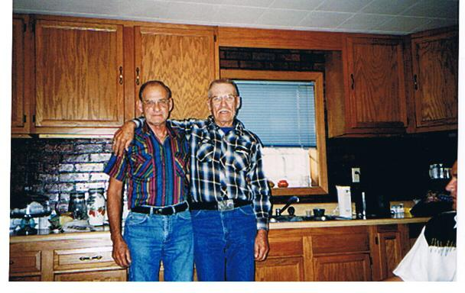
David & Duddle

Slide 11
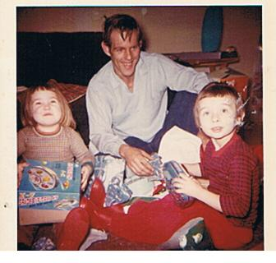
Charles Allen & Children

Slide 12
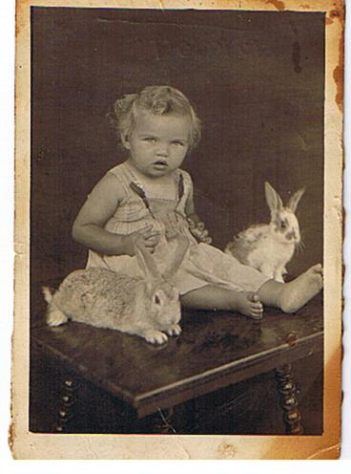
Della Irene Maynard

Slide 13
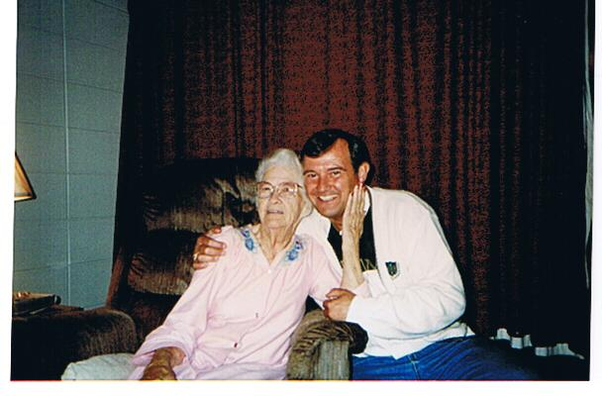
Aunt Nellie & Arnold Jr.

Slide 14
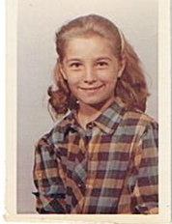
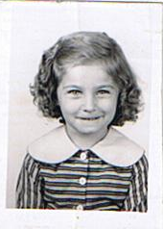
Barbara Lee

Slide 15
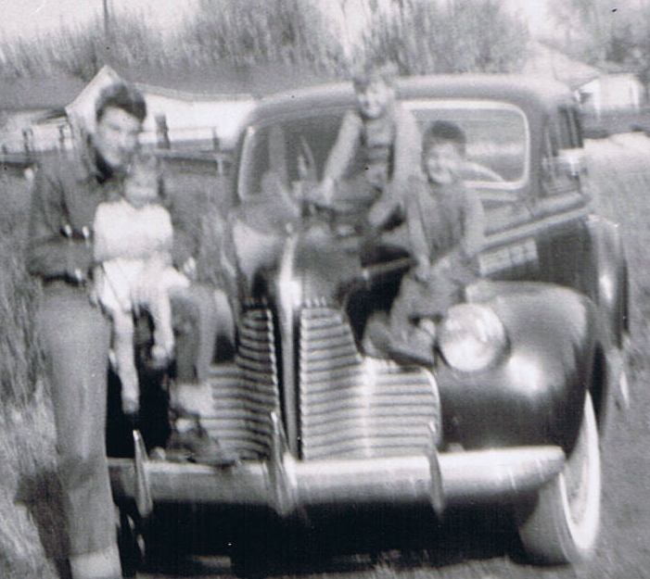
David, Barb, Arnold Jr, John

Slide 16
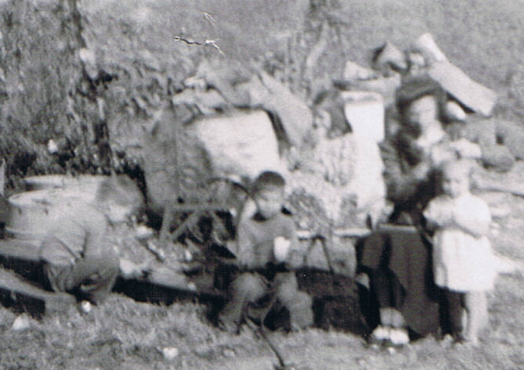
John, Arnold Jr, Frankie, Elizabeth, Frankie

Slide 17
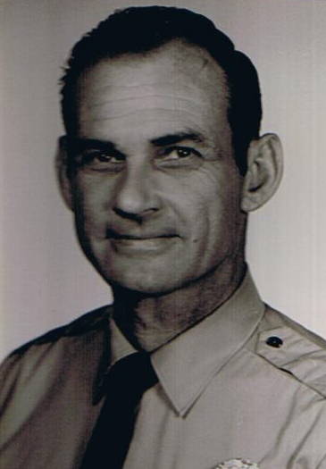
David Maynard

Slide 18
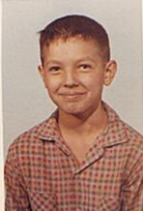
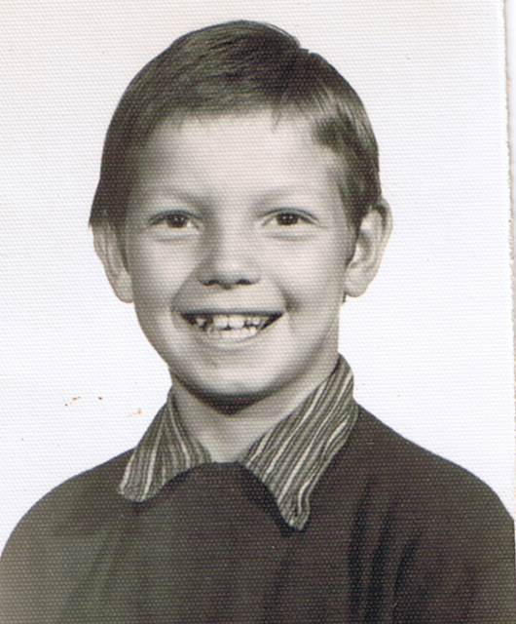
Jerry Maynard

Slide 19
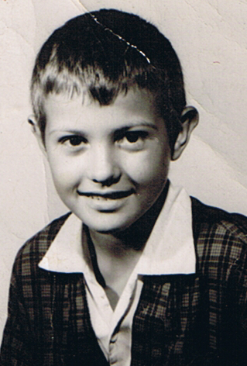
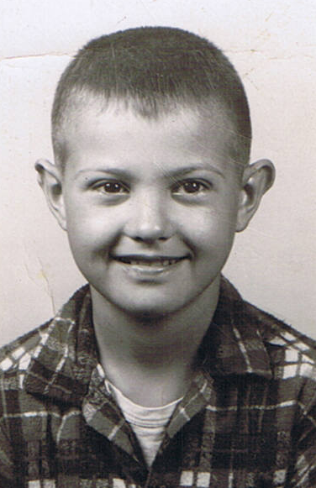
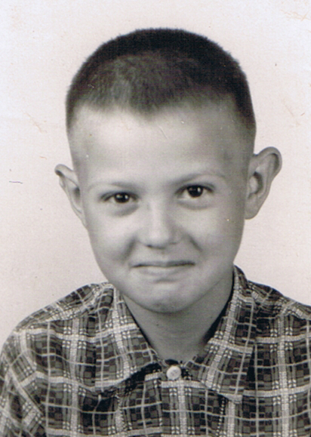
Arnold Jr.

Slide 20
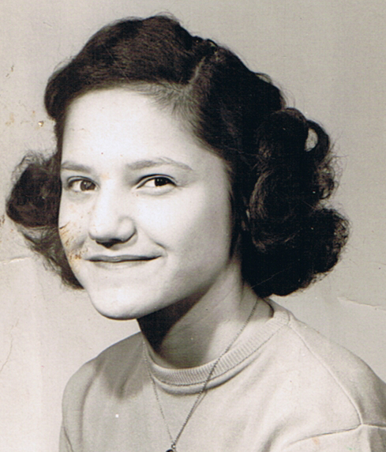
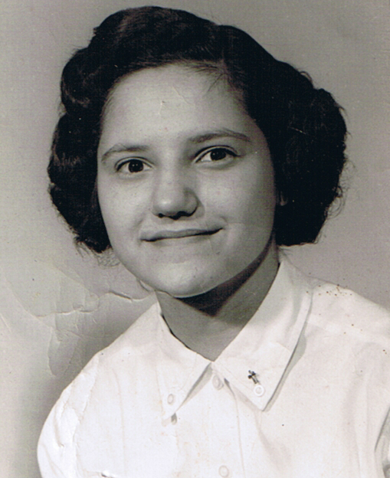
Frankie

Slide 21
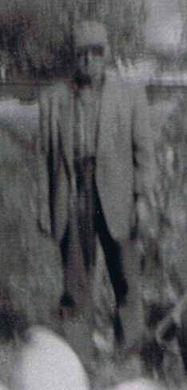
Joe Pap

Slide 22
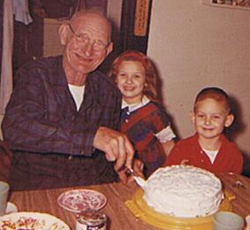
Happy Birthday Joe Pap (Mary & Kelly Joe)

Slide 23
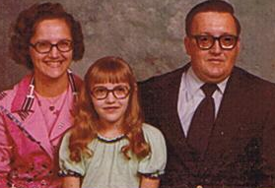
Frankie, Missy & Junior

Slide 24
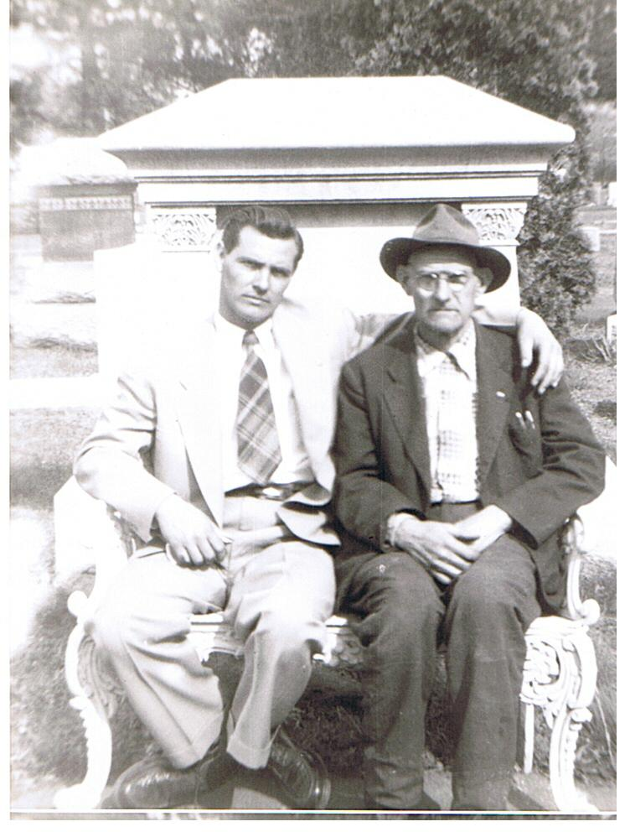
Joe Pap and Arnold Sr.

Slide 25
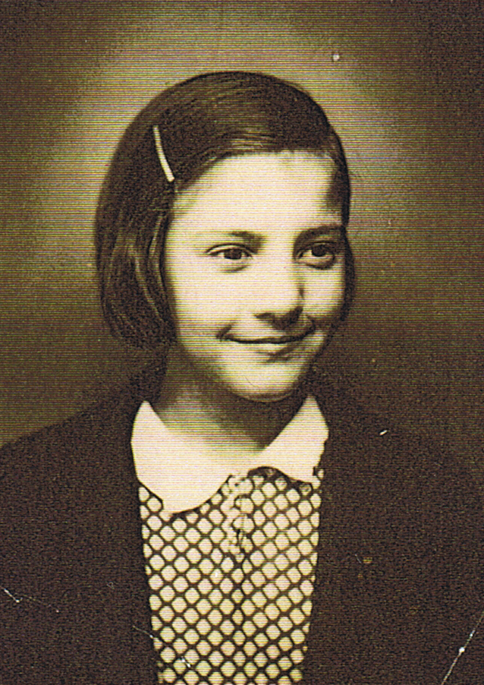
Elizabeth Dove

Slide 26
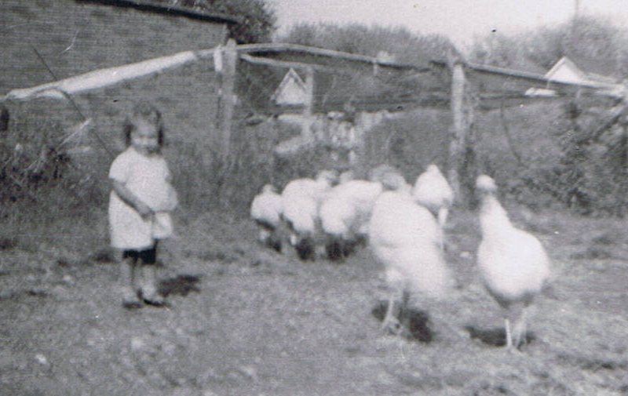
Bobby

Slide 27
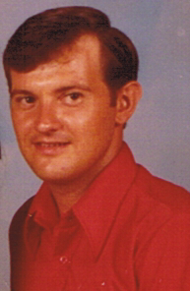
Arnold Jr.

Slide 28
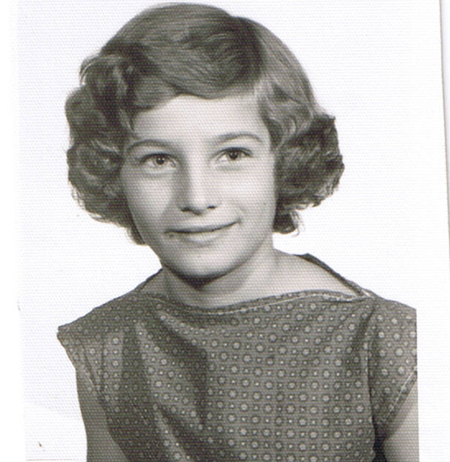
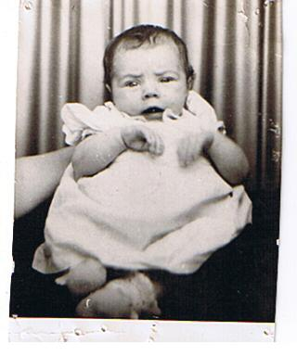
Barb

Slide 29
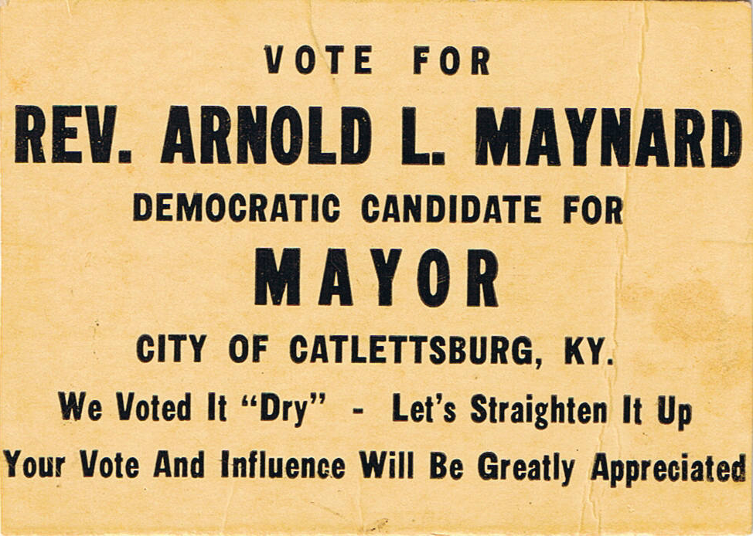

Slide 30
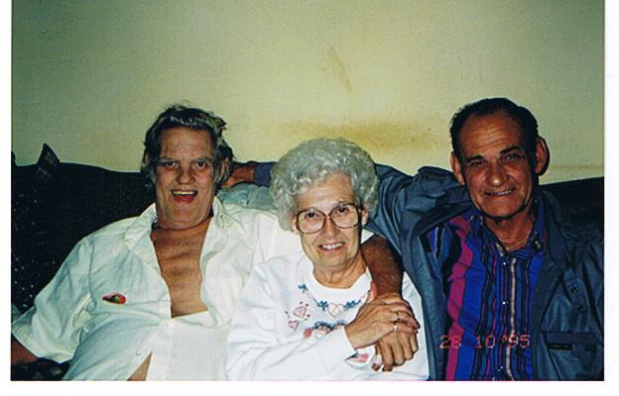
Charles, Garnett & David

Slide 31
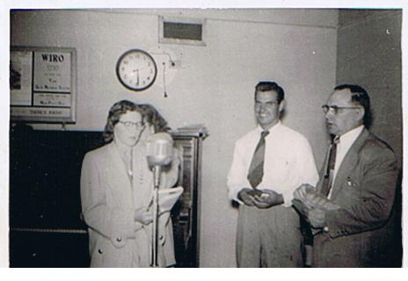
Arnold Sr. at the Radio Station

Slide 32
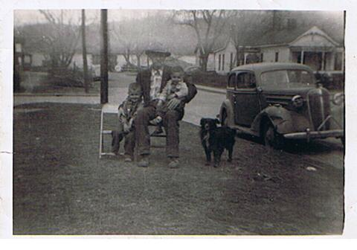
Arnold Jr, Joe Pap, John Allen & Pepper the dog

Slide 33
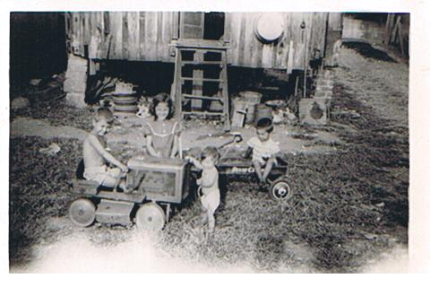
Arnold Jr, Frankie, Barb, John Allen

Slide 34
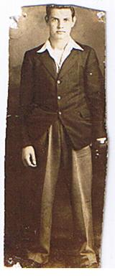
Arnold L Maynard Sr.

Slide 35
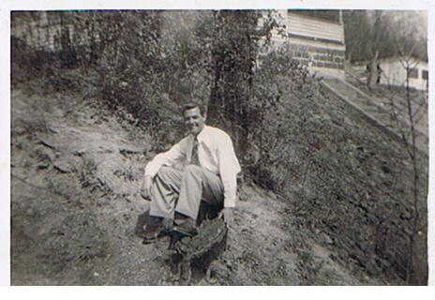
Arnold Maynard Sr.

Slide 36
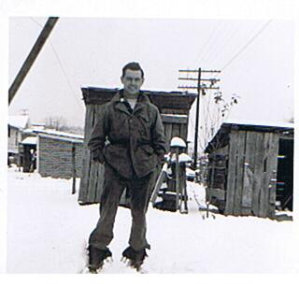
Arnold Maynard Sr.

Slide 37
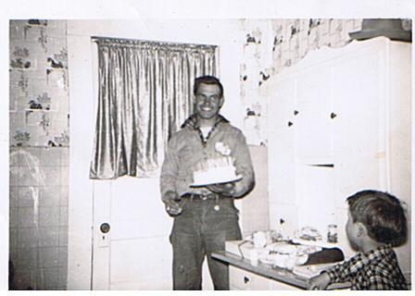
Arnold Sr & Arnold Jr.

Slide 38
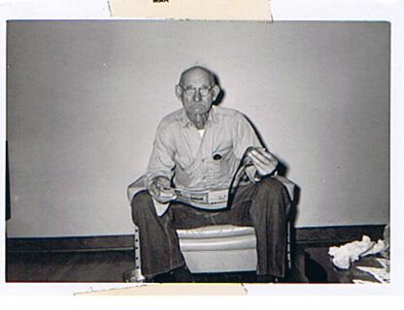
Joe Pap

Slide 39
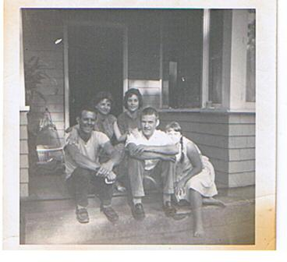
Della Irene, Josey, Charles & Sandra

Slide 40
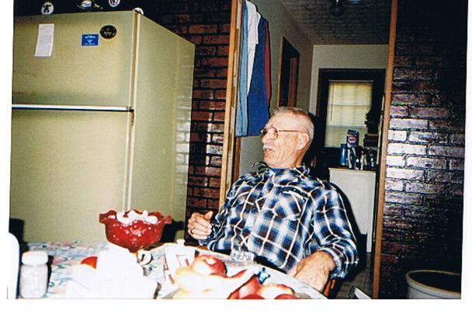
Duddle

Slide 41
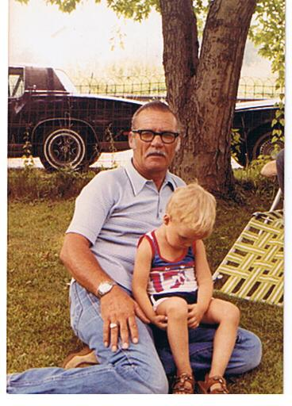
Duddle & Duddle Bug (3 years old)

Slide 42
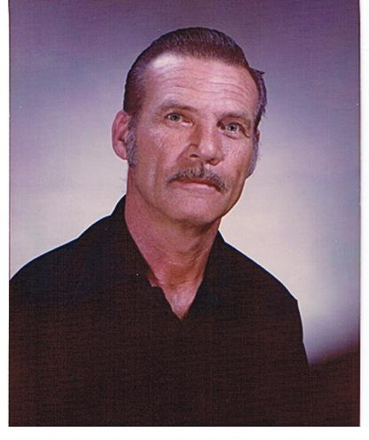
Duddle (Joe Oliver Maynard)

Slide 43
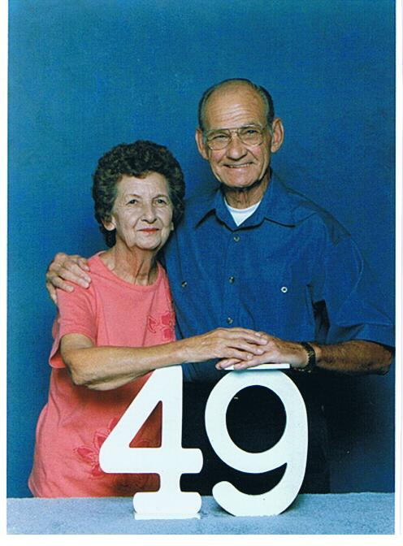
Evelyn & David (49th Anniversary)

Slide 44
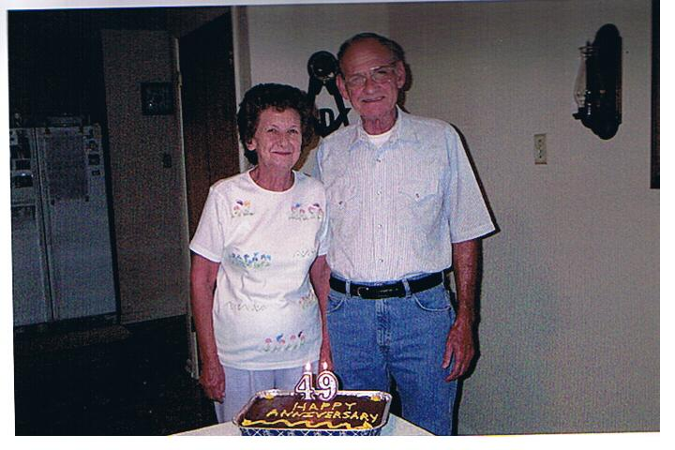
Evelyn & David Lee

Slide 45
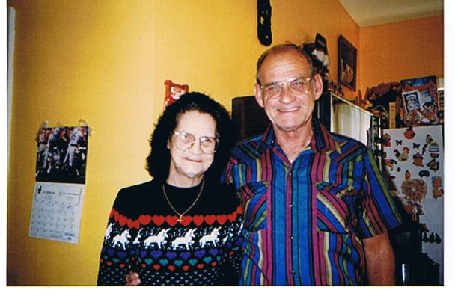
Elizabeth & David

Slide 46

Garnette

Slide 47

Garnette Marie Maynard-Evans

Slide 48

John, David & Arnold

Slide 49

Libby & David

Slide 50

Mark, Arnold & David

Slide 51

Mark, Arnold, Elizabeth & David

Slide 52

Michael Joe Maynard

Slide 53

Myrtle Mae Maynard

Slide 54

Myrtle Mae, Charles Allen & David Lee

Slide 55

Myrtle Mae, Garnette Marie, Charles Allen & David Lee

Slide 56

Nancy, Arnold, David & Duddle

Slide 57

Charles Allen

Slide 58

Nancy David and Duddle

Slide 59

Carl Dove & Arnold Sr.

Slide 60

Charles Allen & David Lee

Slide 61


Jerry David Maynard

Slide 62

Rev. Arnold L. Maynard Sr.

Slide 63


Frankie, Arnold Jr., John & Barbara

Slide 64


John Allen & Arnold Jr.
John, Frankie,
Barbara, Arnold Jr.

Slide 65


John Allen

Slide 66

Jamie, Kailyn, & Tony

Slide 67

Libby Ann

Slide 68

Mary & David Lee

Slide 69

David Lee

